Slide 1

Genz College Admission Prediction
Presented By:
V. Ravalika
Batch N0:480

Slide 2

About Me:
I have done my B.Tech in Electrical and Electronics Engineering.
I have choose Datascience because it allows to combine Technical skills, Analytical thinking, and Real-world problem solving to create meaningful impact using data.
Below are my LinkedIn and GitHub profile URLs
https://www.linkedin.com/in/v-ravalika
https://github.com/vravalika53

Slide 3

Agenda
Introduction
CRISP ML(Q)
Business Problem
Project Objective
Dataset Overview
Data Preprocessing
Architecture Building
Model Evaluation
Model Deployment
Challenges
Final Business Insights
Recommendations
Conclusion

Slide 4
Introduction
College admission is one of the most important processes for educational institutions. Every year, colleges receive thousands of applications from students with different academic achievements, extracurricular activities, and personal backgrounds. Evaluating all these applications manually is time-consuming, resource-intensive, and may lead to inconsistent decisions.
With the advancement of Deep Learning, educational institutions can use predictive models to assist in the admission process. By analyzing historical student data, these models can identify patterns that influence admission decisions and predict whether a new applicant is likely to be admitted.

Slide 5
CRISP(ML)-Q Methodology
CRISP-ML(Q) is a framework used for machine learning project development.
Business and Data Understanding Identify the problem and understand the dataset.
Data Preparation
Clean and transform the data.
Model Architecture Train the machine learning model.
Model Evaluation
Test the model performance.
Model Deployment
Implement the model in a real system.
Monitoring & Maintenance
Continuously check and improve the model

Slide 6
Business Problem
How can a college use historical student data to predict admission chances and make the application screening process faster and more efficient.
Key business challenges:
Large number of applications – Manually checking every application takes time.
Time-consuming screening – Admission teams need to evaluate many factors for each student.
Inconsistent evaluation – Manual assessment may vary between reviewers.
Difficulty identifying suitable candidates – Important patterns may not be obvious from raw data.
Need for faster decisions – Colleges want to process applications efficiently.

Slide 7
Objective of the Problem
Educational institutions require a reliable and data-driven system that can analyze student information and predict the likelihood of admission. Such a system can help admission officers identify eligible candidates more efficiently, improve the consistency of admission decisions, and reduce the overall time required for application screening.
Develop an Artificial Neural Network (ANN) model to predict whether a student will be admitted to college based on academic performance, family background, extracurricular activities, standardized test scores, essays, recommendations, and interview performance.
The model will assist admission officers in making faster, more consistent, and data-driven admission decisions.

Slide 8
Dataset Overview
Total Rows: 500000
Total Features: 20
Volunteer Hours
Leadership Positions
Coding Projects
Social Media Usage
Online Certifications
Essay Score
Recommendation Score
Interview Score
Admission Status
Age
Student_ID
Gender
State
Family Income
High School GPA
SAT Score
ACT Score
Attendance Rate
AP Courses
Extracurricular Activities

Slide 9
Data Preprocessing
Data Cleaning & Preparation
Removed unnecessary columns: Student_ID
Defined target variable: Admission Status
Separated: Features (x) and Target (y)
Numerical Columns: Age,Family_Income,High_school_gpa,Sat_score,Act_score,Attendance_rate,
Ap_score ,extracurricular_count, volunteer_hours, leadership_positions, coding_projects,
social_media_hrs, online_certifications,essay_score,recommendation_score,interview_score.
Categorical Columns: Two Categorical Columns
Encode Categorical Variables: Ordinal Encoding (Ordered Columns): Gender,State

Slide 10
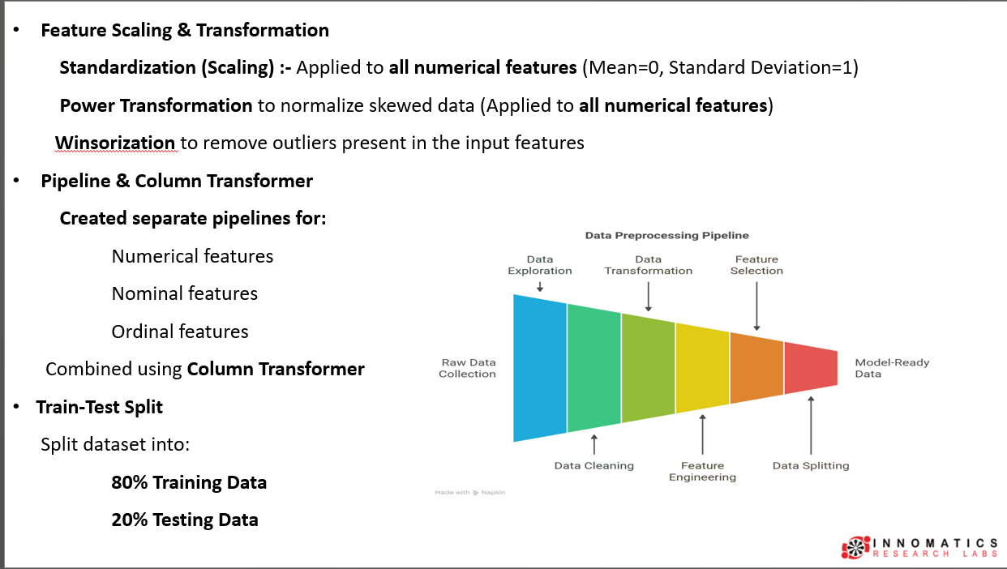

Slide 11
Building Architecture
Input Layer
Takes all preprocessed input features.
Number of neurons = Number of input features.
Hidden Layer 1
64 neurons
ReLU activation
Learns basic patterns from the input data.
Hidden Layer 2
32 neurons
ReLU activation
Extracts more meaningful and complex features.
Hidden Layer 3
16 neurons
ReLU activation
Learns high-level feature representations before prediction.
Output Layer
1 neuron
Sigmoid activation (Produces a probability between 0 and 1).
≥ 0.5 → Admitted
< 0.5 → Not Admitted

Slide 12
Model Evaluation
The ANN model was compiled using the following configuration:
Optimizer: Selected through Hyperparameter Tuning (Adam)
Loss Function: Binary Cross-Entropy
Evaluation Metrics:
Accuracy: Measures the overall percentage of correct predictions(80%)
Precision: Measures how many predicted admitted students were actually admitted(96%)
Recall: Measures how many actual admitted students were correctly identified by the model(80%)

Slide 13
Best Hyperparameters:
Number of Hidden Layers: 3
Learning Rate: 0.002589
Batch Size: 64
Activation Function: Relu
Optimizer: Adam
Hidden Layer 1
Neurons: 256
Dropout: 0.3225
L2 Regularization: 0.0000177
Hidden Layer 2
Neurons: 64
Dropout: 0.1350
L2 Regularization: 0.003884
Hidden Layer 3
Neurons: 16
Dropout: 0.3472
L2 Regularization: 0.0006567
Best Validation Accuracy: 81.12%

Slide 14
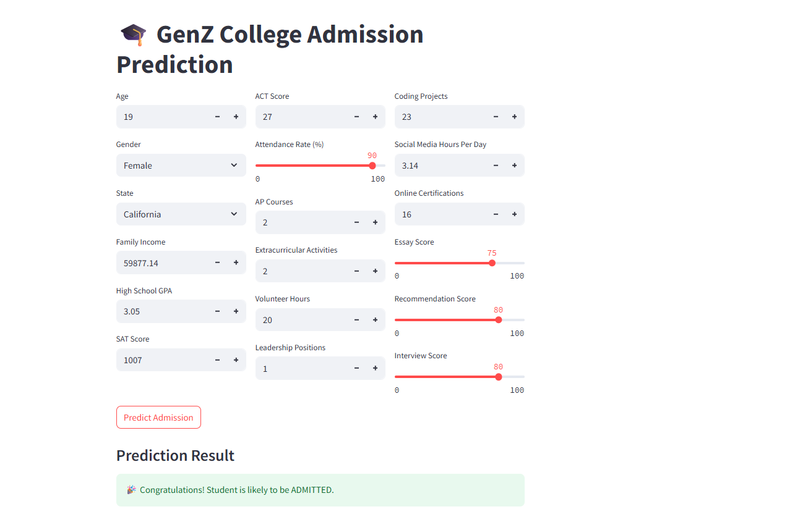

Slide 15
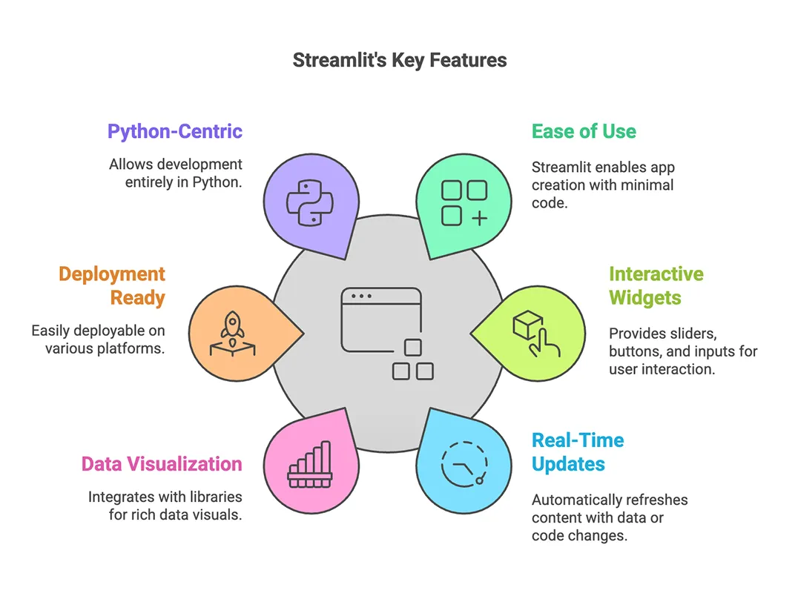
Model Deployment
Developed an interactive web application using Streamlit.
Designed a user-friendly interface to collect student details.
Enabled real-time predictions without requiring programming knowledge.
Simplified the admission prediction process through an easy-to-use web interface.
Makes the admission prediction process fast, simple, and accessible.
The application can be deployed on Streamlit Community Cloud

Slide 16
Challenges
Large dataset increased training time.
Solution: Used batch training and optimized the ANN model.
Model started overfitting after several epochs.
Solution: Applied Dropout, L2 Regularization, and Early Stopping,
Batch_Normalization.
Imbalanced dataset (more admitted students than non-admitted students).
Solution: Applied Class Weights during model training to give higher
importance to the minority class.

Slide 17
Final Key Insights
Academic performance such as GPA, SAT, and ACT scores is an important factor in predicting admission.
Essay, recommendation, and interview scores help evaluate the student's overall profile.
Extracurricular activities, leadership, volunteering, and certifications provide additional information about student potential.
The ANN model can help identify students who are more likely to be admitted based on their overall profile.
Class imbalance was handled using class weights, helping the model consider both admission classes during training.
The model was optimized using Optuna, achieving a best validation accuracy.
The Streamlit application provides quick, real-time admission predictions.

Slide 18
Recommendations
Collect additional features such as awards, internships, and research experience to improve prediction accuracy.
Periodically retrain the model using new admission data.
Apply feature selection to remove less important variables.
Experiment with advanced deep learning architectures and ensemble models.
Integrate the model into the college admission portal for automated application screening.

Slide 19
Conclusion
Developed an Artificial Neural Network (ANN) to predict college admission status.
Performed data preprocessing and hyperparameter tuning.
Achieved a Best Validation Accuracy of 81.12%.
Successfully deployed the model using Streamlit for real-time predictions.
The solution supports faster, consistent, and data-driven admission decisions while reducing manual effort.

Slide 20


Slide 21


